Slide 1

PRE-IDEATHON TEMPLATE
GENESIS
IDEATHON
TEAM & DOMAIN
Introduce your team and the domain you have chosen
Team Name – Byte Me
Team Members – Jeffrey Immanuel J – CB.EN.U4ARE26026
Jagan Sai Reddy - CB.AI.U4AIM26012
Gayathri T K - CB.AI.U4AIM26013
Yazhini B - CB.AI.U4AIM26062
Selected Domain – #5
Problem Statement – Generative Bio Digital Twin

Slide 2


DOMAIN PROBLEM IN OUR WORDS
TEAM
Byte Me
Explain the problem in your domain simply, in your own words
What needs to be solved?
Developing climate-resilient crops still depends on months of costly trial and error.
Scientists need a faster way to identify and test genetic changes that improve drought resistance without reducing crop yield or quality.
We need to produce more food while working with limited land, water, and other resources.
Why is it important right now?
The global population is projected to reach around 9.7 billion by 2050.
Global food production may need to increase by around 60% by 2050 to meet growing demand.
Climate change is increasing pressure on agriculture through drought, changing weather patterns, and resource scarcity.
Traditional breeding and field testing take too long to keep pace with these challenges.
The core challenge
We need to grow more food, with fewer resources, in a climate that is becoming increasingly unpredictable.

Slide 3
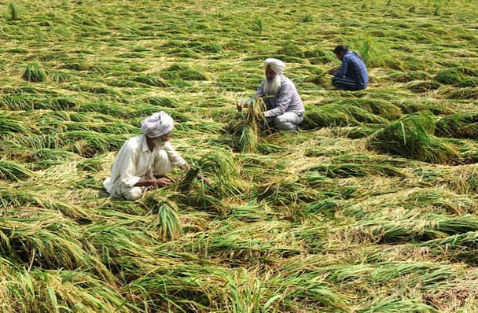
WHO IS AFFECTED?
TEAM
Byte Me
Target users, stakeholders, beneficiaries
Primary Users / Target Group
Agricultural Biotechnologists & Plant Breeders use AI driven analysis
to identify promising gene targets and evaluate potential edits computationally.
AgTech & Seed R&D Companies reduce costly trial and error by screening candidate edits before conducting physical experiments.
Farmers & Crop Growers benefit from crop varieties developed for better resilience against drought, heat, and other regional climate stresses.

Slide 4
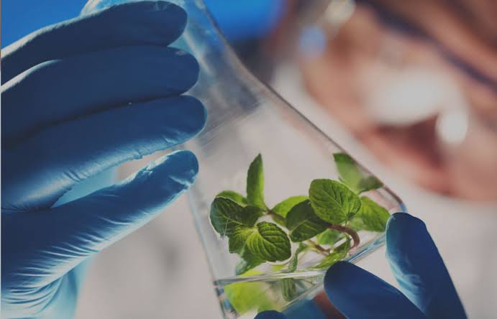
WHO IS AFFECTED?
TEAM
Byte Me
Target users, stakeholders, beneficiaries
Secondary Stakeholders
Consumers & Food Retailers benefit from more stable food supplies and potentially reduced price fluctuations caused by crop failures.
Agricultural Insurers & Lenders could experience lower financial
risk if climate resilient crops reduce severe agricultural losses.
Governments & Environmental Organizations benefit from improved food security planning and the potential for more
efficient water and fertilizer use.

Slide 5
WHO IS AFFECTED?
TEAM
Byte Me
Target users, stakeholders, beneficiaries
Who benefits if the problem is solved?
The entire agricultural ecosystem benefits, from researchers developing improved crop varieties to farmers cultivating them and consumers relying on a stable food supply.

Slide 6
CURRENT SITUATION & CONTEXT
TEAM
Byte Me
Existing scenario, background and how things work today
Existing Scenario & Background
Crop improvement is becoming increasingly challenging as rising temperatures, droughts, and unpredictable weather affect agricultural productivity. Current crop breeding and gene editing workflows still depend on extensive laboratory experiments and field trials, making it difficult to predict how genetic changes will perform under real environmental conditions.

Slide 7
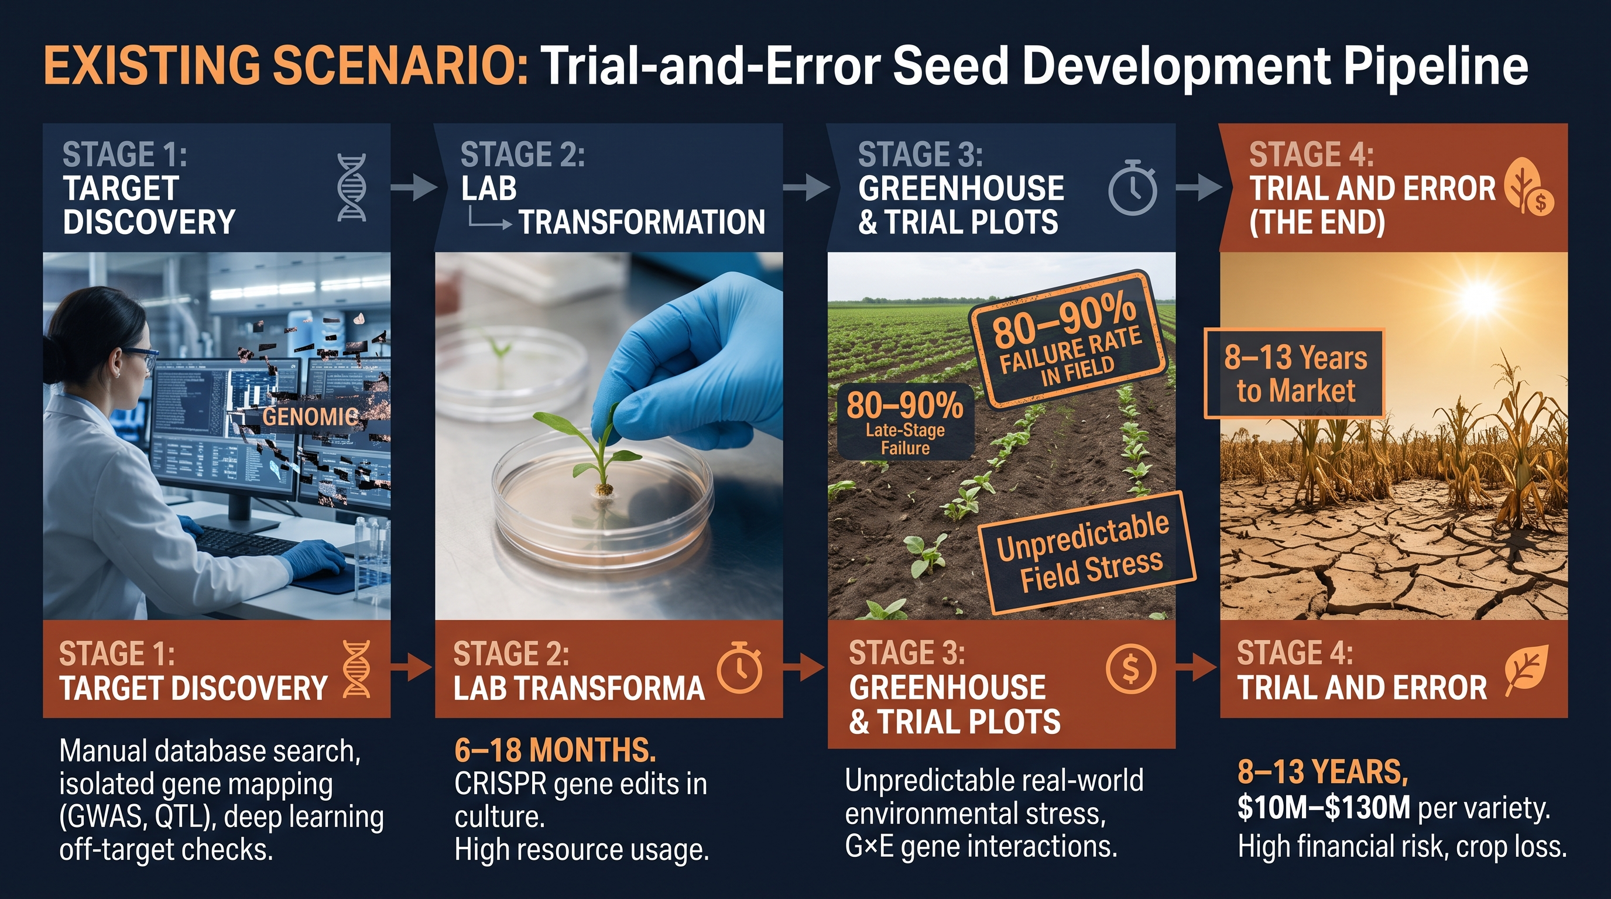
CURRENT SITUATION & CONTEXT
TEAM
Byte Me

Slide 8
CURRENT SITUATION & CONTEXT
TEAM
Byte Me
Existing scenario, background and how things work today
Relevant Data / Facts
The United Nations projects that the global population will approach 9.7 billion by 2050, increasing pressure on food systems.
The FAO estimates that global agriculture may need to produce approximately 50% more food, feed, and fibre by 2050 compared with 2012 levels.
Climate stress and the interaction between genes and environmental conditions make the development of reliable, resilient crop varieties more challenging.

Slide 9
CURRENT SITUATION & CONTEXT
TEAM
Byte Me
Existing scenario, background and how things work today
Current Workflow — Step by Step
Gene Identification - Researchers manually identify potential gene targets using genomic databases and scientific literature.
Edit Design - Bioinformatics tools help design and assess candidate gene edits.
Laboratory Testing - Researchers introduce selected edits into plant material and grow experimental plants.
Field Trials - Plants are tested under real growing conditions to evaluate their performance.
Evaluation & Repetition - If the desired traits are not achieved, researchers revise the approach and repeat the process, increasing time and cost.

Slide 10
KEY CHALLENGES
TEAM
Byte Me
Main difficulties, bottlenecks, root causes and consequences
Main Difficulties & Bottlenecks
Long development cycles and expensive laboratory and field experiments.
Limited ability to predict how genetic modifications will perform under changing environmental conditions.
Potential trade offs between desirable traits, such as drought tolerance, crop yield, and quality.
Difficulty integrating genomic, environmental, and crop-performance data.

Slide 11
KEY CHALLENGES
TEAM
Byte Me
Main difficulties, bottlenecks, root causes and consequences
Root Causes
Existing bioinformatics tools often focus on individual stages of the genetic analysis workflow.
Environmental data and molecular level biological data are frequently stored and analysed separately.
Complex gene environment interactions are difficult to model using static datasets and conventional prediction methods.

Slide 12
KEY CHALLENGES
TEAM
Byte Me
Main difficulties, bottlenecks, root causes and consequences
Consequences of Leaving Them Unsolved
Crop development may struggle to keep pace with climate change.
Repeated experimental failures can increase research costs, expose farmers to greater crop-loss risks, and place additional pressure on global food security.

Slide 13
EXISTING SOLUTIONS / APPROACHES
TEAM
Byte Me
What is already being done, and where it falls short
Existing Methods, Systems or Alternatives
CRISPR Design and Analysis Tools support guide RNA design, sequence analysis, and assessment of potential off target effects.
Computational Biology & Multi Omics Analysis help researchers investigate gene expression, biological pathways, and relationships between genes and traits.
Agricultural IoT and Precision Farming Platforms monitor field conditions such as temperature, soil moisture, humidity, and light intensity.
Conventional Breeding and Field Trials provide real-world evidence of crop performance under different growing conditions.

Slide 14
EXISTING SOLUTIONS / APPROACHES
TEAM
Byte Me
What is already being done, and where it falls short
Limitations of Each
CRISPR Tools evaluate specific aspects of gene editing performance but generally do not predict complete crop performance across changing field environments.
Multi Omics Tools generate valuable biological insights, but integrating these findings into environmental predictions remains challenging.
IoT Platforms monitor field conditions but typically do not connect those measurements directly to molecular level genetic models.
Field Trials are essential for validation, but they require time, resources, and repeated experiments.

Slide 15
EXISTING SOLUTIONS / APPROACHES
TEAM
Byte Me
What is already being done, and where it falls short
The Gap They Leave Open (Our Opportunity)
There is an opportunity to integrate multi omics data, AI based gene analysis, environmental information, and crop performance simulation into one interactive digital twin. This platform would help researchers compare candidate genetic modifications under different climate scenarios before prioritising physical experiments.

Slide 16
PROBLEM INSIGHTS & OPPORTUNITY AREAS
TEAM
Byte Me
Resources required to solve the problem
Software Requirements
Bioinformatics & CRISPR - BioPython, CRISPOR, Ensembl Plants.
Biological & Climate Modelling - COBRApy, APSIM/DSSAT for metabolic pathways and crop performance prediction.
AI & Development - PyTorch, scikit-learn, Python and React/Three.js for predictive modelling and digital twin visualisation.

Slide 17
PROBLEM INSIGHTS & OPPORTUNITY AREAS
TEAM
Byte Me
Resources required to solve the problem
Hardware & Infrastructure
Workstation with 32–64 GB RAM and a dedicated GPU.
Cloud GPU/HPC for advanced AI and structural modelling.
IoT sensors for temperature, soil moisture, humidity and light.

Slide 18
PROBLEM INSIGHTS & OPPORTUNITY AREAS
TEAM
Byte Me
Resources required to solve the problem
Human Resources
Computational Biologist - Gene and pathway analysis.
AI/ML Engineer - Predictive models and multi omics integration.
Software Engineer - Platform and dashboard development.
Agronomist - Crop and climate simulation validation.

Slide 19
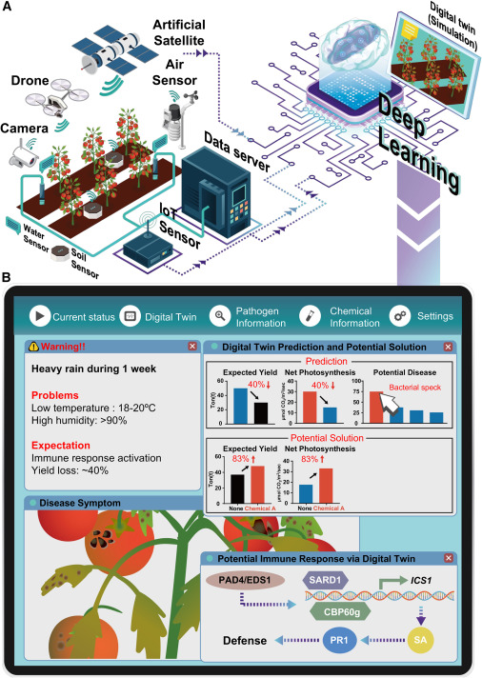
INITIAL DIRECTION & EXPECTED OUTCOME
TEAM
Byte Me
What Is Your Expected Outcome?
What Our Team Intends to Do
Develop the Generative Bio Digital Twin, an AI powered platform that combines multi omics data, candidate gene editing analysis, and environmental information to simulate and compare the predicted performance of crop varieties under different climate conditions.
The platform will provide an interactive 3D crop model, environmental visualisations, and AI generated insights to support researchers in identifying promising candidates for further testing.

Slide 20
INITIAL DIRECTION & EXPECTED OUTCOME
TEAM
Byte Me
What Is Your Expected Outcome?
What We Want to Improve
Connect crop genetics with real world environmental conditions.
Reduce dependence on unguided trial and error during early stage research.
Make biological and environmental data easier to analyse through one integrated platform.
Help researchers prioritise promising edits before committing to resource-intensive physical experiments.

Slide 21
INITIAL DIRECTION & EXPECTED OUTCOME
TEAM
Byte Me
What Is Your Expected Outcome?
What Successful Improvement Should We Achieve?
Our initial goal is to demonstrate a working prototype that accepts biological and environmental data, compares candidate crop modifications across selected climate scenarios, and produces interpretable predictions of potential crop performance.
This could help accelerate early stage screening, reduce avoidable experimental costs, and support the development of climate resilient crops. Laboratory testing and field trials would remain necessary to verify the predictions.

Slide 22
TEAM CONTRIBUTION
TEAM
Byte Me
Who will handle which part of the execution
Team Member | Role | Responsibility in Execution
Jeffrey Immanuel J | Biology and research | Active research
Yazhini B | Ai/ml and evaluation | Dataset preparation,baseline model
Jagan sai reddy | Crop Modelling | Real time scenario and feasability
Gayathri T K | Research and review | Crop,drought traits and biological assumptions

